Slide 1

Giving it a Voice

Slide 2
Objectives
Discuss the pros and cons of various voice chatbot options
Understand how Watson Speech APIs work
Integrate Watson Assistant and Watson Text to Speech and Speech to Text services
Voice Chatbot

Slide 3
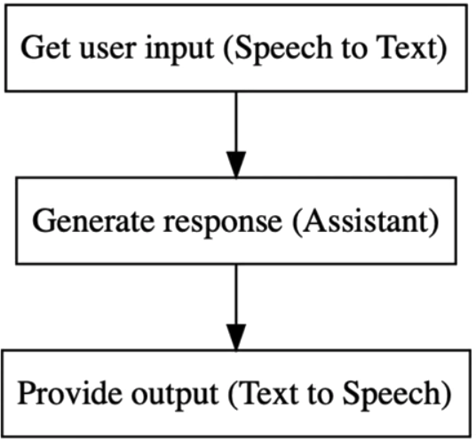
Adding Watson Speech Service
The architecture:
  User input via audio.
  The Watson Speech To Text service will transcribe an audio recording from the user. Then, this text can be passed to the Assistant to figure out what Watson’s response is.
  Watson’s response can be synthesized with the Text to Speech service.
Voice Chatbot

Slide 4
Adding Watson Speech Service
Project Scenario: You are an AI specialist and you are entrusted with the responsibility of building a voice enabled chatbot. You are building amarkey viable product to see the feasibility. In this product:
  We will be posting a query to the chatbot through an audio file (mp3/wav).
  This audio will then be converted to text by the SpeechToText service.
  The text returned by the SpeechToText service will be passed to the Watson Assistant.
Voice Chatbot

Slide 5
Adding Watson Speech Service
  The response from Watson Assistant is in the form of a JSON
  We extract the text from the JSON and the convert that into speech
  The speech is rendered to the client through an embedded audio tag
  The dialog can be continuous as we create a session with Watson Assistant and maintain it.
Voice Chatbot

Slide 6
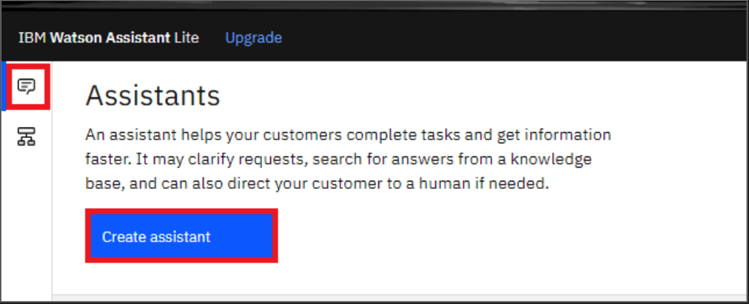
Adding Watson Speech Service
Task 1: Add Customer Care skill on Watson Assistant:
On your Watson Assistant page, click on Create Assistant
Voice Chatbot

Slide 7
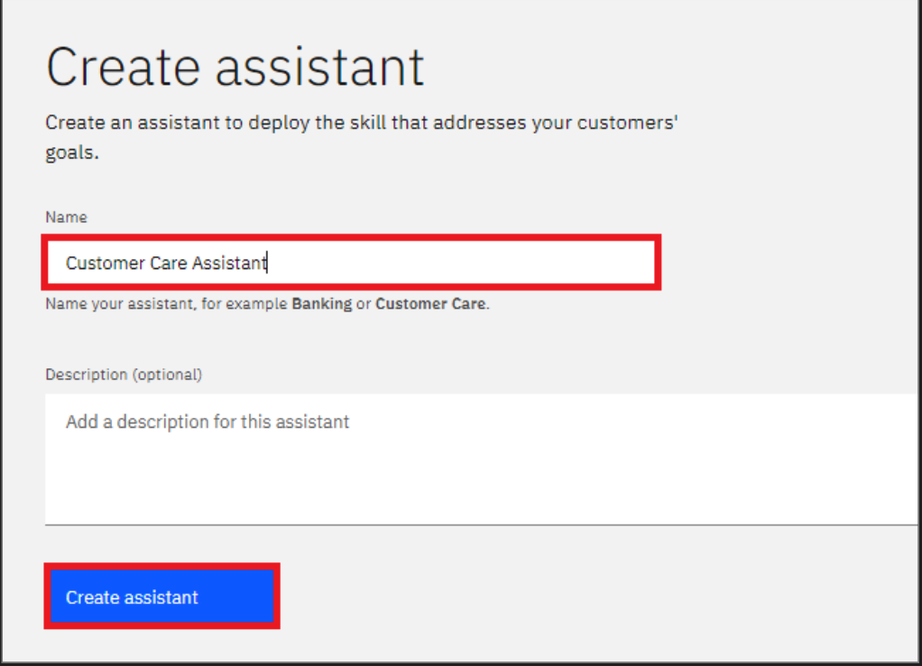
Adding Watson Speech Service
Task 1: Add Customer Care skill on Watson Assistant:
On the Create Assistant page, add a name to your assistant, like Customer Care Assistant
Voice Chatbot

Slide 8
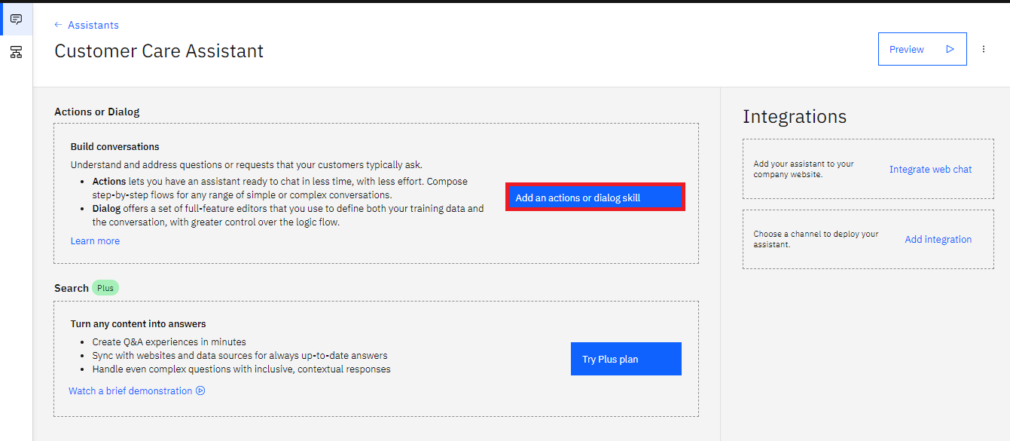
Adding Watson Speech Service
Task 1: Add Customer Care skill on Watson Assistant:
Once your assistant is created, click on Add an actions or dialog skill, to add a skill to your assistant:
Voice Chatbot

Slide 9
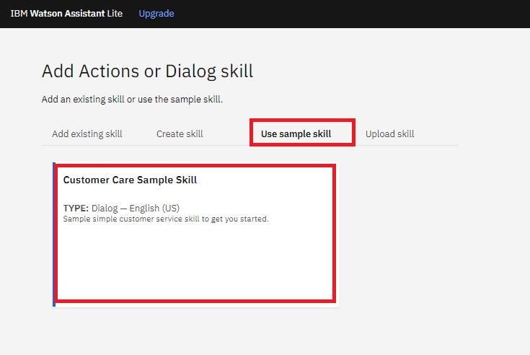
Adding Watson Speech Service
Task 1: Add Customer Care skill on Watson Assistant:
Click on Use sample skill and select Customer Case Sample Skill
Voice Chatbot

Slide 10
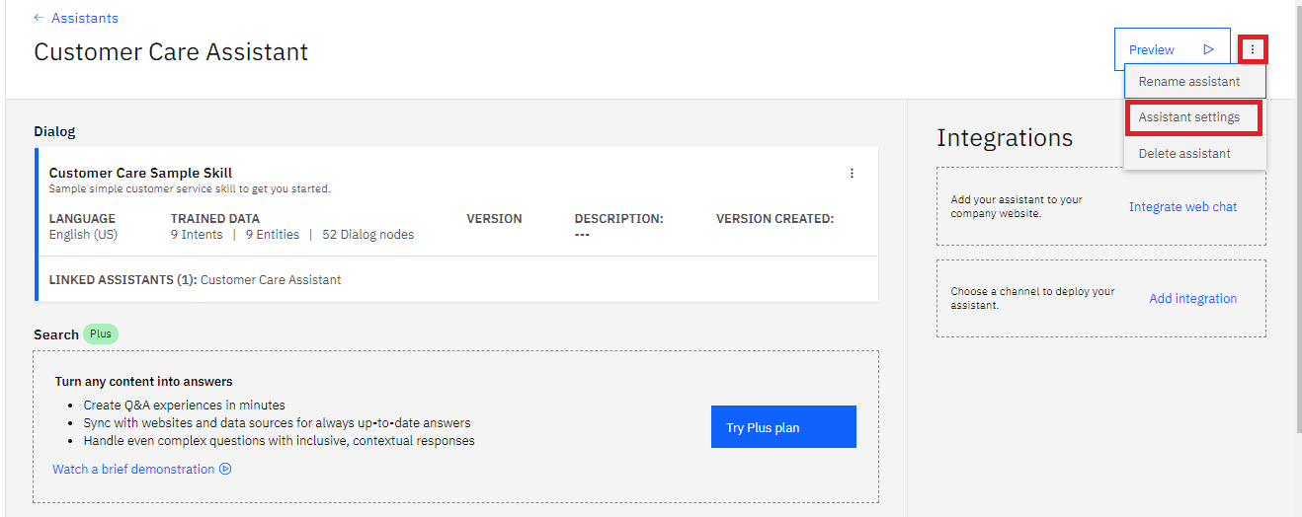
Adding Watson Speech Service
Task 1: Add Customer Care skill on Watson Assistant:
To get your Assistant ID, you need to go to your Assistant settings
Voice Chatbot

Slide 11
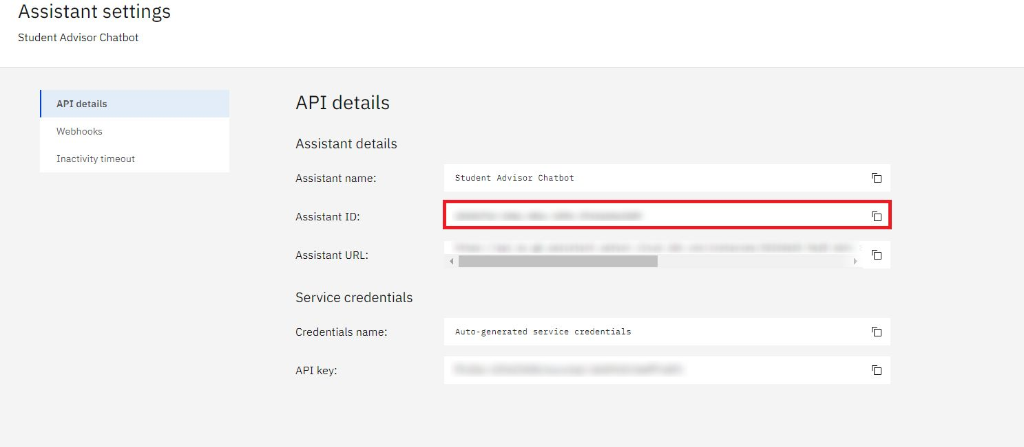
Adding Watson Speech Service
Task 1: Add Customer Care skill on Watson Assistant:
Voice Chatbot

Slide 12
Adding Watson Speech Service
Task 2: adding Watson speech service
Download the audio_dialogs.zip in your local folder and extract it. It has a few sample dialogs you can upload and get response for.
Download the code:
- git clone https://github.com/ibm-developer-skills-network/cb106-AIWatsonLab.git
cd cb106-AIWatsonLab
We need to import the right modules for this lab. All the modules have been included in the requirements.txt. In the file explorer look through the requirement to check the same: pip3 install -r requirements.txt
Voice Chatbot

Slide 13
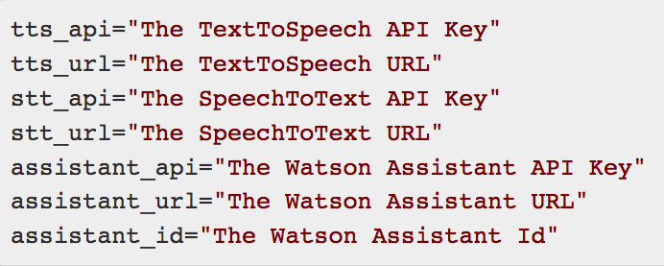
Adding Watson Speech Service
Task 2: adding Watson speech service
- You will see .env in the ibmservices folder. Fill up the values for the API keys from the services you have created.
Voice Chatbot

Slide 14
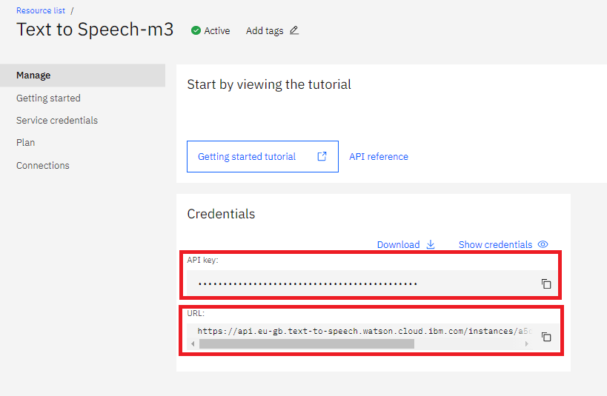
Adding Watson Speech Service
Task 2: adding Watson speech service
- To get your TextToSpeech service API Key and URL, open the TestToSpeech service from your IBM Cloud Resource list:
Voice Chatbot

Slide 15
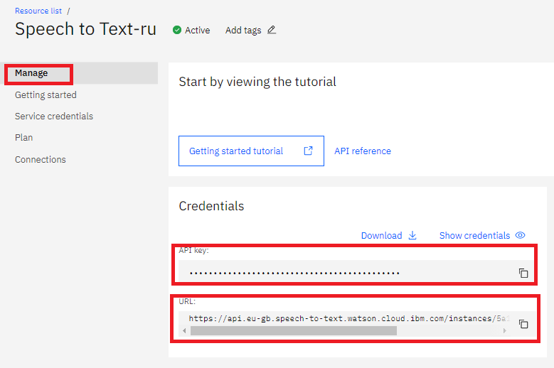
Adding Watson Speech Service
Task 2: adding Watson speech service
- Get your SpeechToText service API Key and URL, open the SpeechToText service from your IBM Cloud Resource list:
Voice Chatbot

Slide 16
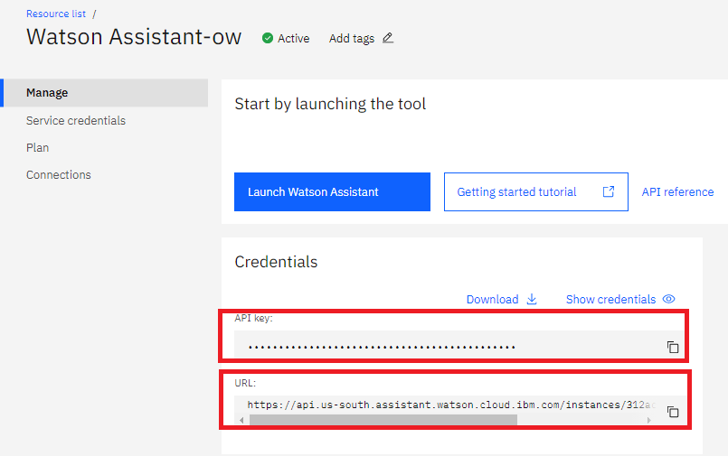
Adding Watson Speech Service
Task 2: adding Watson speech service
- Get your Watson Assistant service API Key and URL, open the Watson Assistant service from your IBM Cloud Resource list:
Voice Chatbot

Slide 17

Adding Watson Speech Service
Task 2: adding Watson speech service
- Start the server:
Voice Chatbot

Slide 18
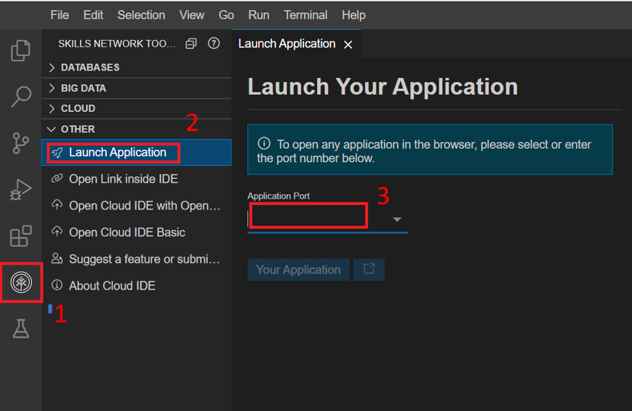
Adding Watson Speech Service
Task 2: adding Watson speech service
- Click on the Skills Network button on the left, it will open the Skills Network Toolbox. Then click the Other then Launch Application. From there you should be able to enter the port.
Voice Chatbot

Slide 19
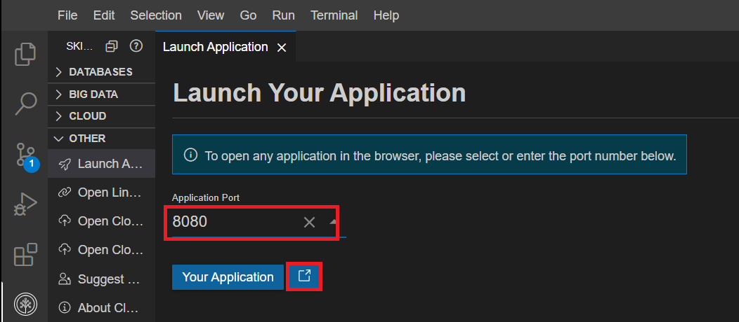
Adding Watson Speech Service
Task 2: adding Watson speech service
- Connect to port 8080and click Launch button.
Voice Chatbot

Slide 20
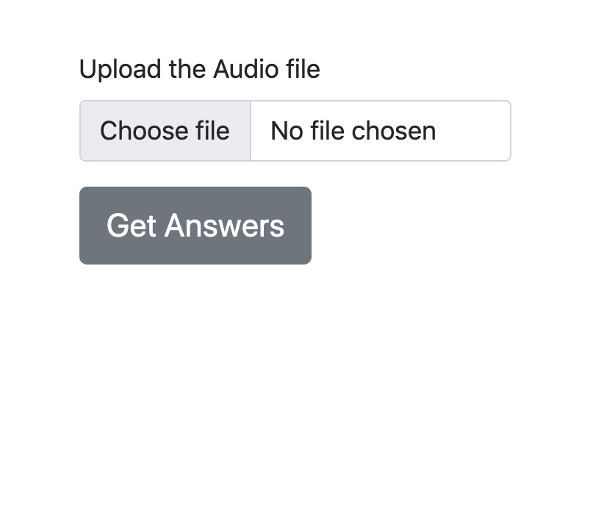
Adding Watson Speech Service
Task 2: adding Watson speech service
- You should see this page open up.
Voice Chatbot

Slide 21
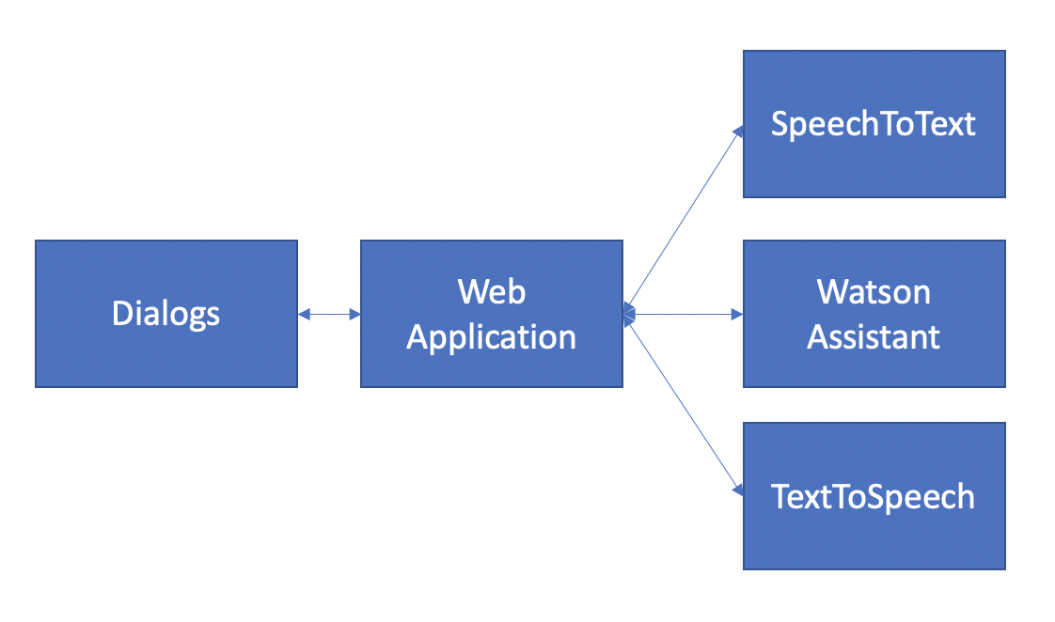
Adding Watson Speech Service
Task 2: adding Watson speech service
- You may recall the flow of the question and response as explained in the beginning of this document.
Voice Chatbot

Slide 22
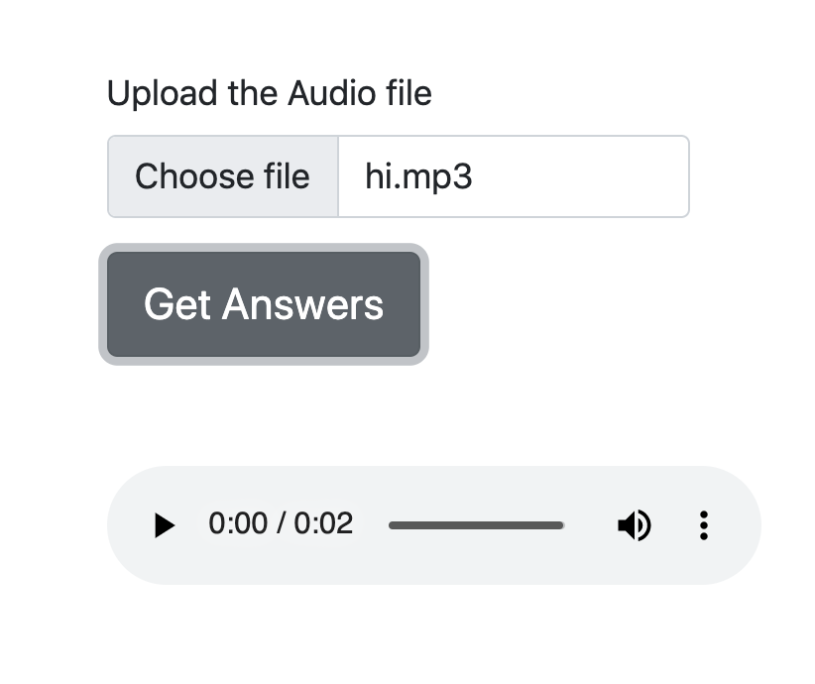
Adding Watson Speech Service
Task 2: adding Watson speech service
You can record some mp3/wav files with the questions that are supported by your chatbot. Some questions have been provided in the zip file. You can upload the dialogs and listen to the response that's returned.
The response is returned in mp3 format.
Voice Chatbot

Slide 23
Summary
Discuss the pros and cons of various voice chatbot options
Understand how Watson Speech APIs work
Integrate Watson Assistant and Watson Text to Speech and Speech to Text services
Voice Chatbot

Slide 24
Q & A
Voice Chatbot

